Slide 1
Unit 5 – Storytelling and World Building

Slide 2
Overview
Why Am I Playing This Game?
Elements of the Story
Challenge – Developing Your Game World Outline
Storytelling - Choose Your Own Adventure! Choice.
Choose Your Own Adventure – Software
Challenge – Choose Your Own Adventure Story
Challenge – Game World Design and Storytelling

Slide 3
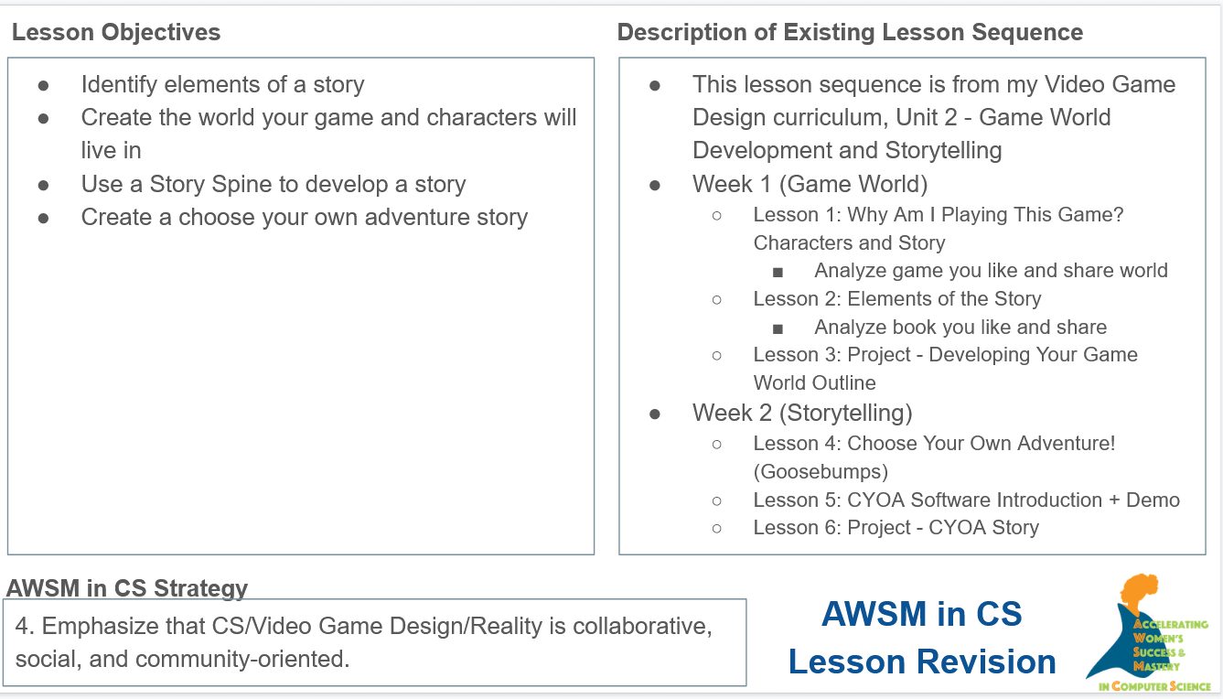

Slide 4
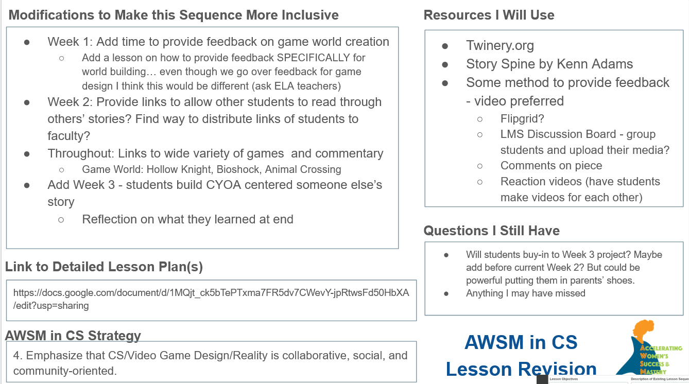

Slide 5
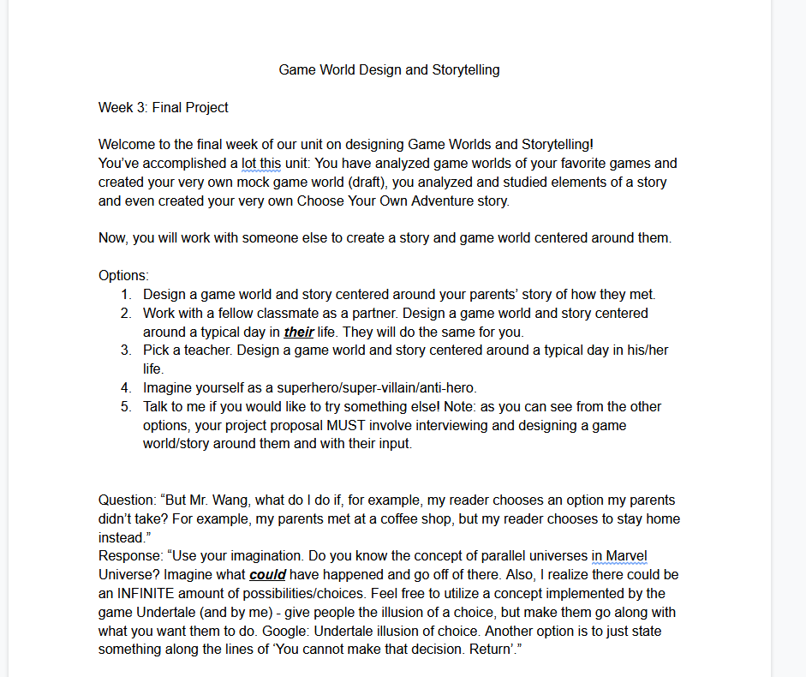

Slide 6
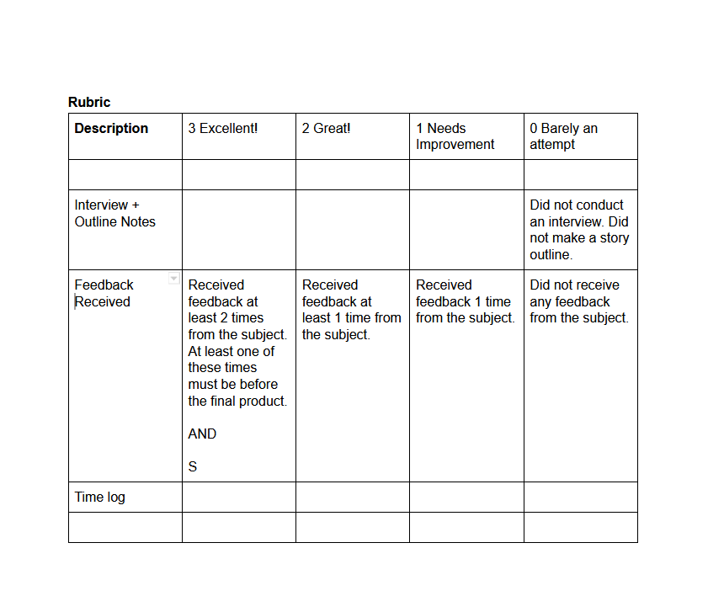

Slide 7
